Slide 1
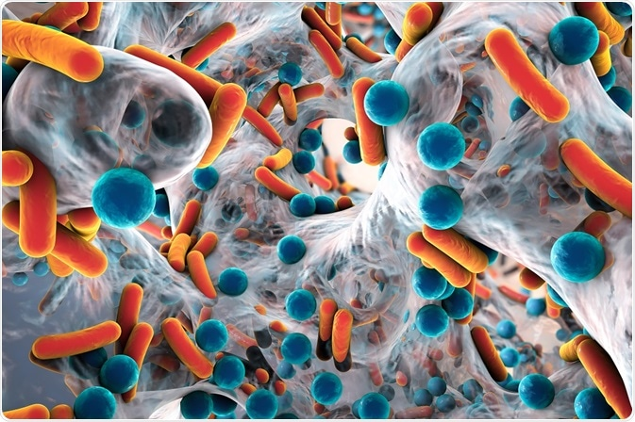
Simple, mechanism-based statistical models provide powerful tools for understanding microbial communities
Collin B. Edwards, Brooke Anderson, Rachel J. Dutton, Benjamin E. Wolfe
Credit: Kateryna Kon/Shutterstock.com
Notes:
Hi everyone, thanks for coming! Today I’m going to present some work that I’ve done to understand community changes in microbiomes. This work serves as a nice example of the challenges of working with sparse biological data.

Slide 2

In recent years, there has been a trend towards Big Data approaches
Start with big data set, many predictors/features
Fit with flexible models
Make predictions
Notes:
Take a really big data set with a lot of predictors (features)
Fit that data with a very flexible model that will capture any patterns
Make predictions! (typically far better for prediction than inference)

Slide 3

Many questions in biology aren’t suited for big data approaches
Small data (expensive, hard to get)
Biological constraints – flexibility isn’t always good
We want models for inference not prediction
Notes:
And instead, valuable research can be carried out by carefully designing or selecting parmetric models for specific datasets and questions.

Slide 4

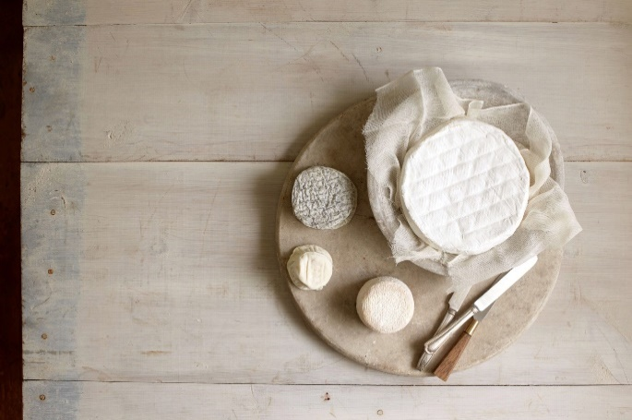
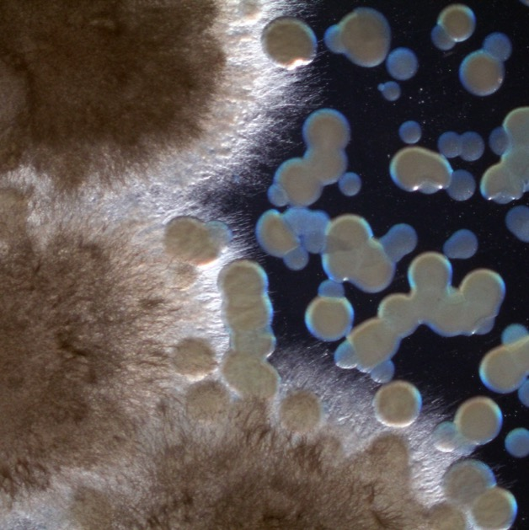
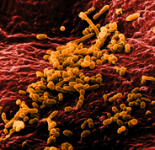
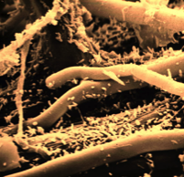


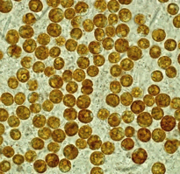
Microbiomes matter… for almost everything
Notes:
I’m going to be talking to you about microbiomes. Recent work by microbial ecologists has shown that that microbiomes can impact human health, plant productivity, the quality of fermented foods, and numerous ecological processes. Ultimately, it would be incredibly useful to be able to manipulate what species are present in a given microbiome – excluding harmful species, promoting useful ones. When people eat yogurt or take probiotics after a series of antibiotics, that’s exactly what they’re trying to do – manipulate their gut microbiome to have more friendly species.

Slide 5
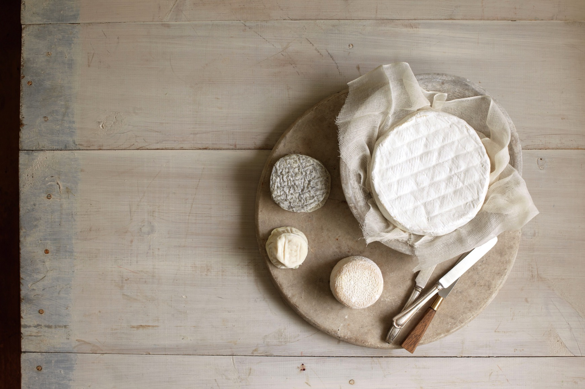
Cheese microbiomes are a good system for understanding microbiomes
Adam Detour
Notes:
- Many shared species between cheese microbiomes and the human gut! But very simplified.

Slide 6
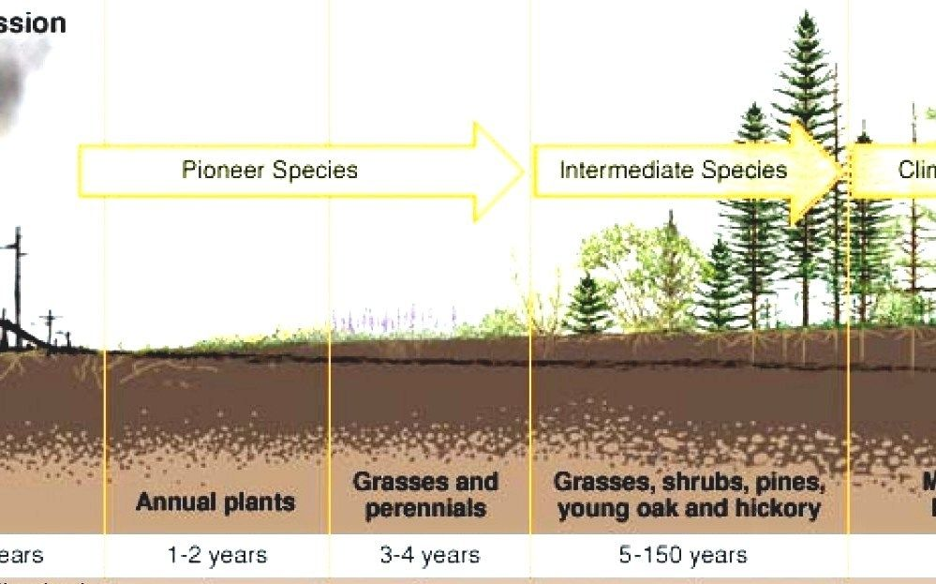
Succession (macro-ecology)
Notes:
If we want to manipulate the species present in a microbiome, it’s helpful to start by looking at natural changes in species composition to see if we can identify drivers of species turnover. You may be familiar with this process in macroecology – we call it “succession” – where, for example, an abandoned field

Slide 7
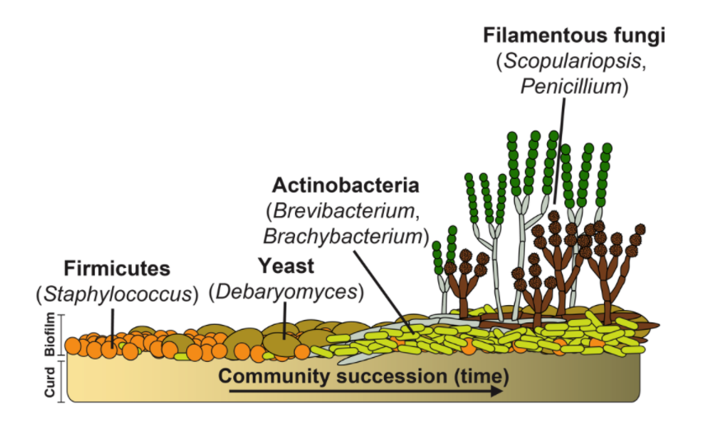
Succession (microbial ecology)
Notes:
It turns out succession also happens in microbiomes! In particular, we have identified a consistent succession process in a 7-species community of the cheese microbiome.

Slide 8
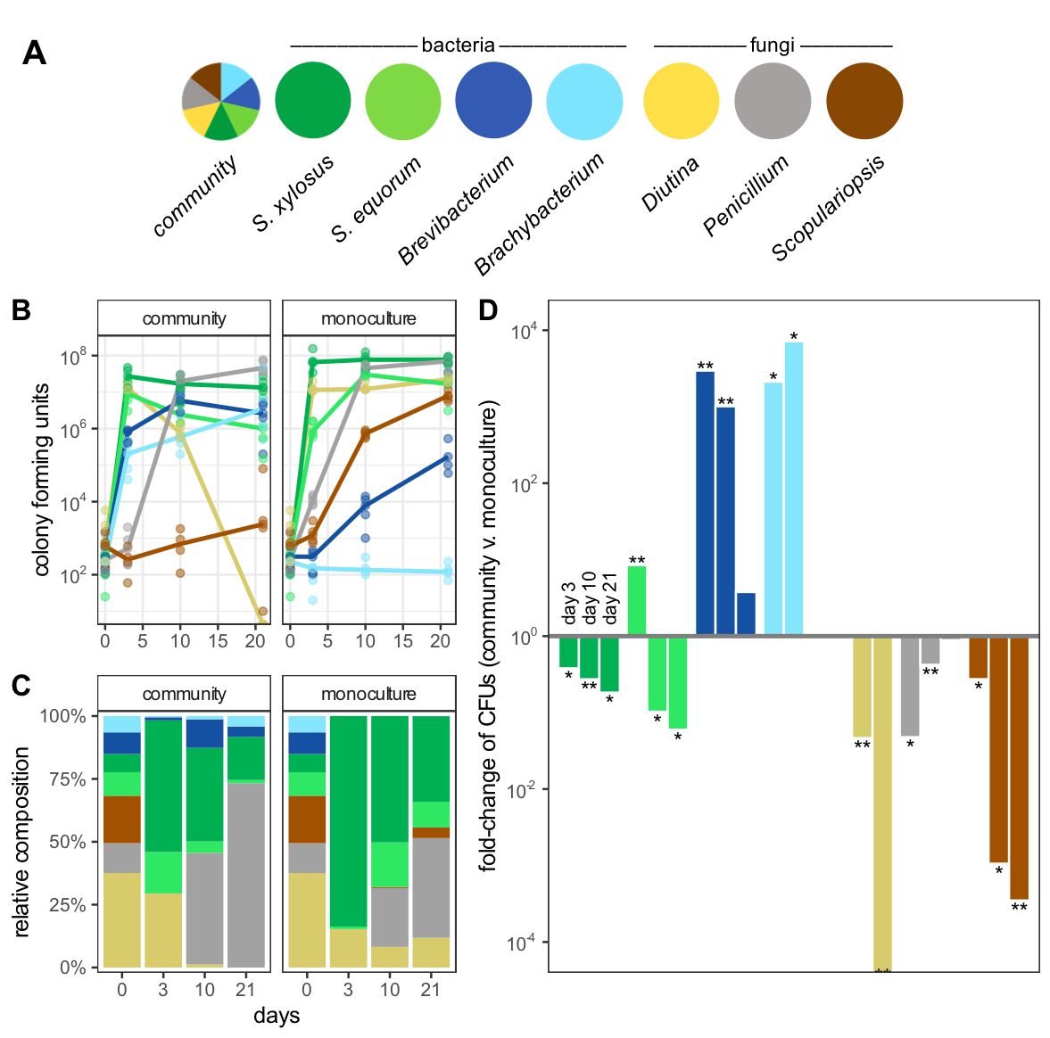

Days
Brooke Anderson
What is driving succession (changes in populations through time)?

Slide 9
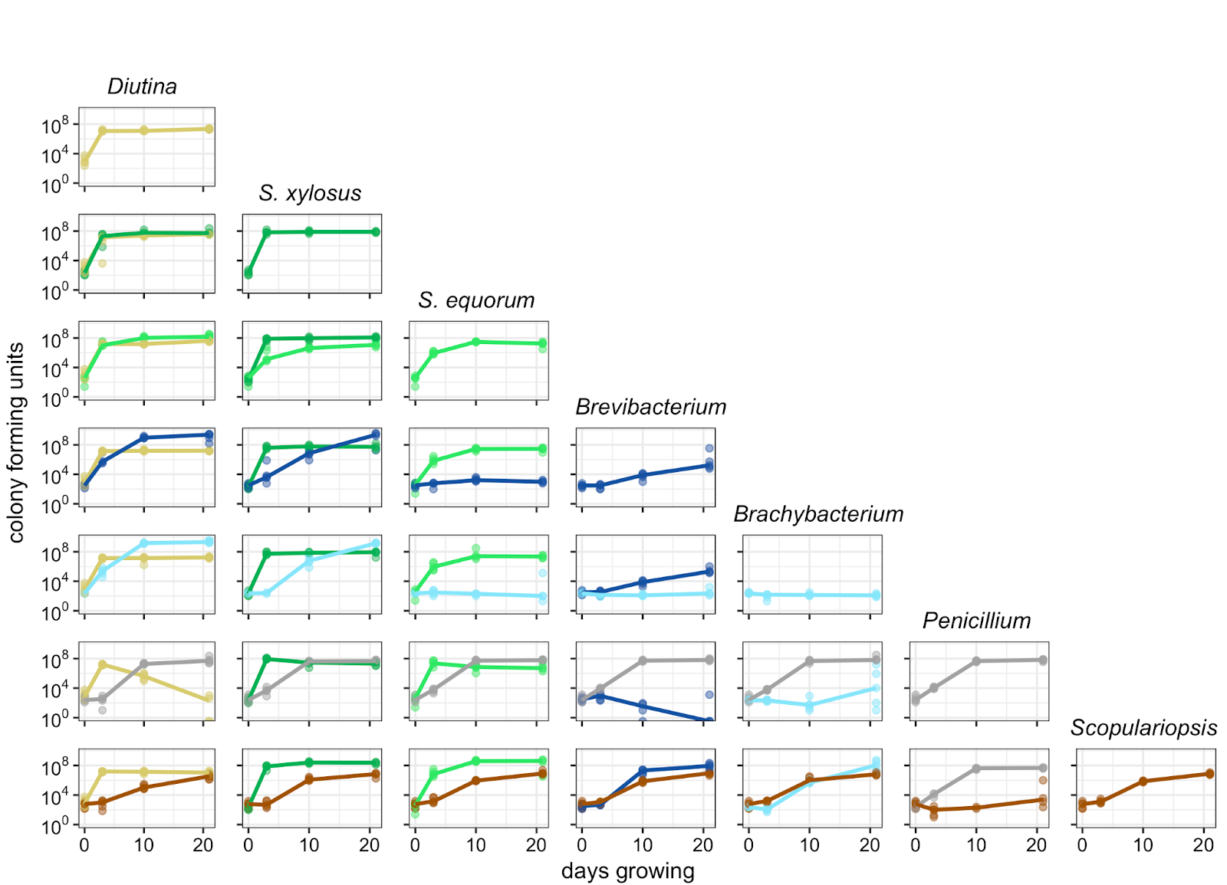
Limitation: data is hard to get
Massive effort
But: 4 points per time series
So flexible models will over-fit

Slide 10
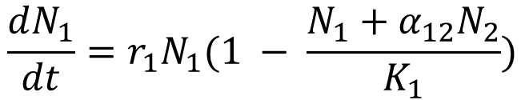
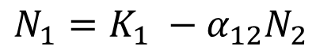
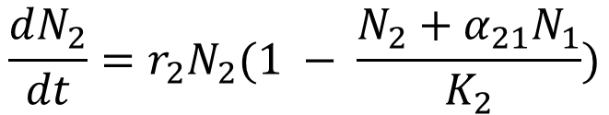
Lotka-Volterra competition
$$\frac{dN_{1}}{dt}=r_{1}N_{1}(1 − \frac{N_{1}+α_{12}N_{2}}{K_{1}})$$
Fitting differential equations to data:
Ordinarily might use trajectory matching
That requires sufficient time points to estimate all 6 parameters for a species pair
$$\frac{dN_{2}}{dt}=r_{2}N_{2}(1 − \frac{N_{2}+α_{21}N_{1}}{K_{2}})$$
SOLUTION: simplify even further. At equilibrium, density of N₁ is
$$N_{1}=K_{1} −α_{12}N_{2}$$
abundance
Now we can use linear regression, and interpret our coefficients through the lens of our mechanistic model
Time
Notes:
Key features: growth is exponential when there’s no competition, in the absence of other species, a given species grows up to carrying capacity K, and the alpha terms define interspecific interactions, with positive values representing competition, and negative values representing facilitation.
Here showing the equations for a 2-species system, but can be extended for any number of species

Slide 11
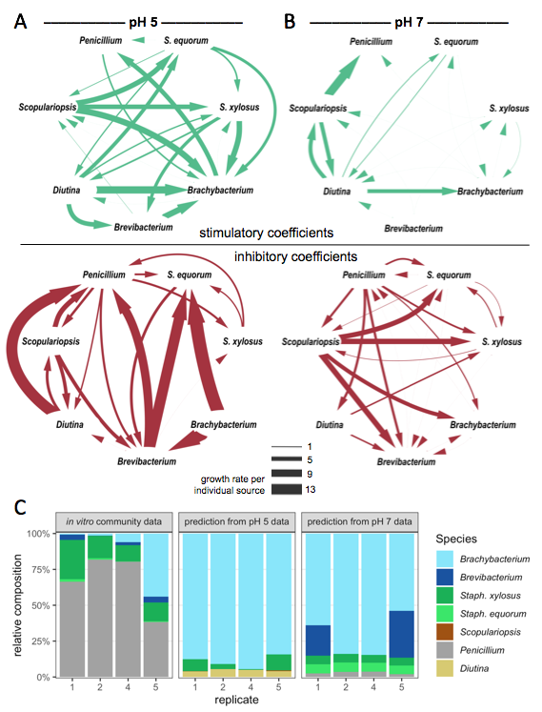
(not surprisingly) regression worked!
Brevibacterium and Brachybacterium were generally very sensitive to neighbors, and were hugely facilitated (negative alphas) by Diutina and S. xylosus
Facilitation (negative alphas)
Penicillium had many large positive alpha values – source of inhibition for many species
Inhibition (positive alphas)
Notes:
NOTE: check with Brooke – these figs seem off.

Slide 12
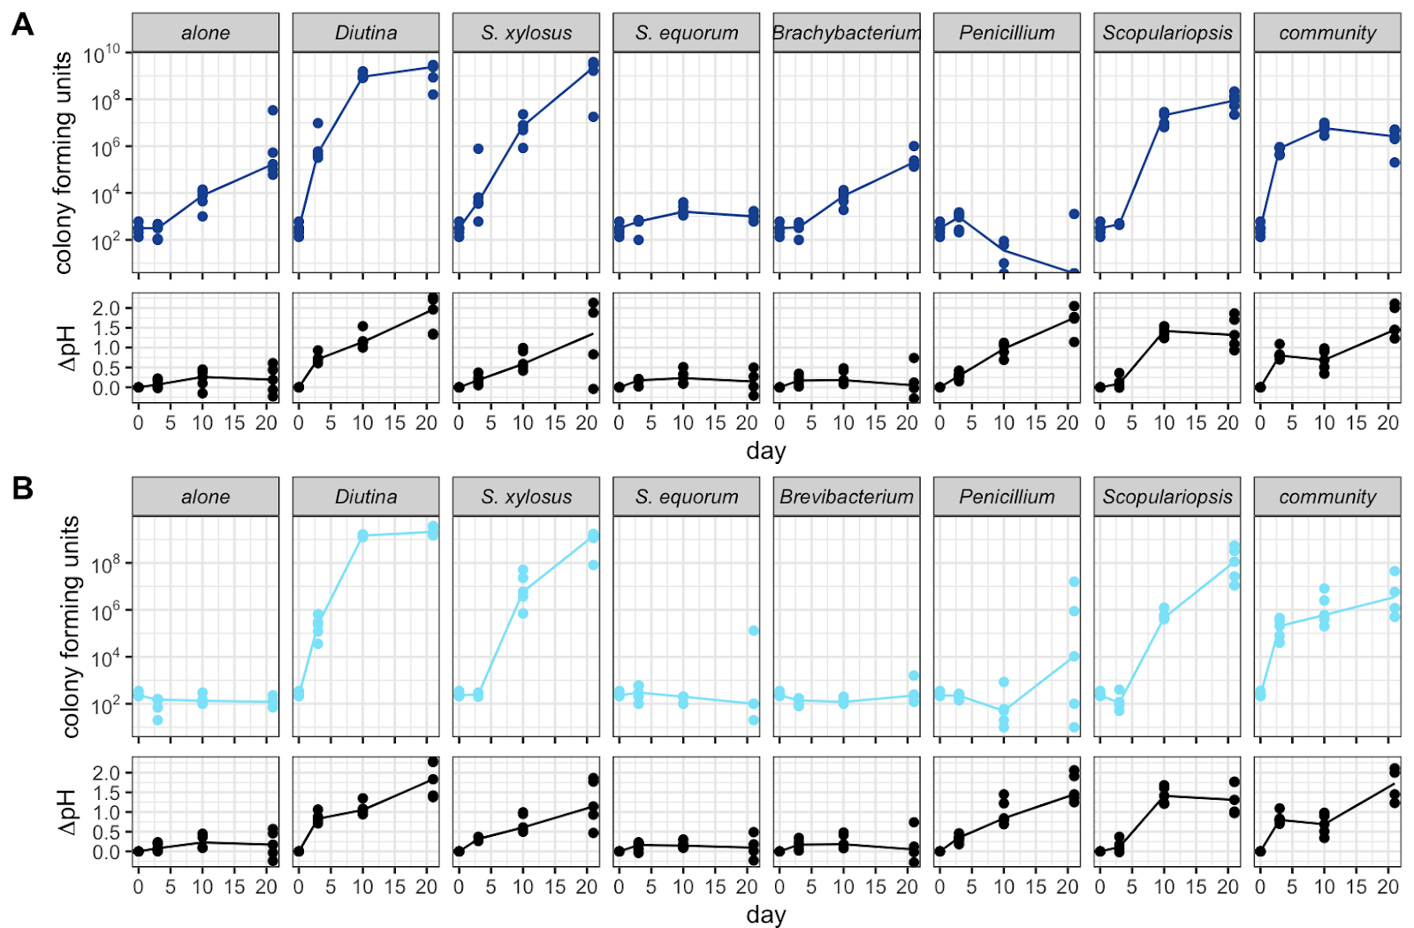
Prefer higher pH (less acidic) substrates
Brevibacterium and Brachybacterium were generally very sensitive to neighbors, and were hugely facilitated (negative alphas) by Diutina and S. xylosus
Diutina
S. xylosus
7
De-acidifiers
pH
5
days
So maybe one of the drivers of succession is the de-acidification provided by Diutina and S. xylosus?

Slide 13
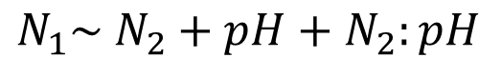
It IS de-acidification!
Started at pH 5 (normal)
Started at pH 7 (closer to final pH)
$$N_{1}\sim N_{2}+pH+N_{2}:pH$$

Slide 14
Produces anti-microbial compounds (e.g. Penicillin!)
Penicillium had many large positive alpha values – source of inhibition for many species
Penicillium
Inhibition (positive alphas)
7
pH
5
days

Slide 15
So…
Succession in this system is driven by
De-acidification from 2 species allowing two other species to flourish
Inhibition from Penicillium

Slide 16
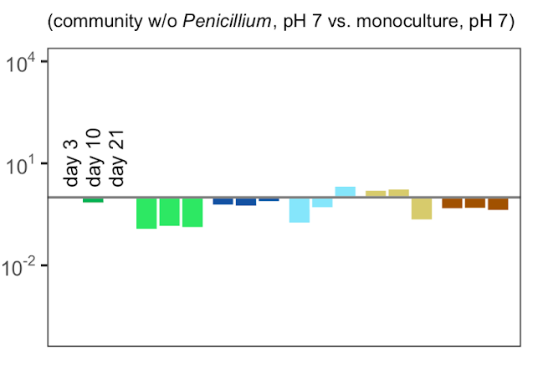
What would succession look like without these drivers?
All grown together vs monocoltures

Slide 17
Big Picture
To analyze this system
Big data methods didn’t work
Forward simulation of mechanistic models didn’t work
Clever math let us turn mechanistic models into a regression problem.
Regression worked
A surprising number of problems can be tackled with clever math and regression.

Slide 18

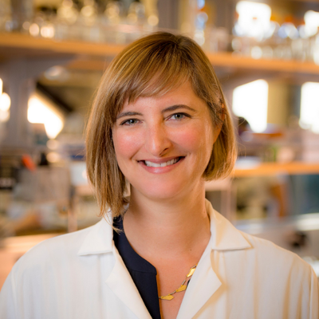

Thanks to:
Data Intensive Studies Center at Tufts University
Dr. Elizabeth Crone
Wolfe Lab
Brooke Anderson
Rachel J. Dutton
Benjamin E. Wolfe
Any questions?
Credit: Kateryna Kon/Shutterstock.com
Notes:
Hi everyone, thanks for coming! Today I’m going to present some work that I’ve done to understand community changes in microbiomes. This work serves as a nice example of the challenges of working with sparse biological data.

